Slide 1


The Galaxy Game
The Galaxy Game
Submitted to:- Dr. Amanpreet Singh
Dr. N. Bhartiraja
Submitted By:- Sanyam Gupta (2210993842) Pratham Gupta (2210993827)

Slide 2
GAME START!
https://docs.google.com/presentation/d/1uSw7OYKGdNR2avnf19IK37K4t1B-5lk7T95EV9yP-Ng/edit#slide=id.p
GAME START!

Slide 3
CONTENTS
INTRODUCTION
CODES
THE GAME
GAME OVER
TABLE OF
TABLE OF
01
02
01
02
03
04
03
04

Slide 4
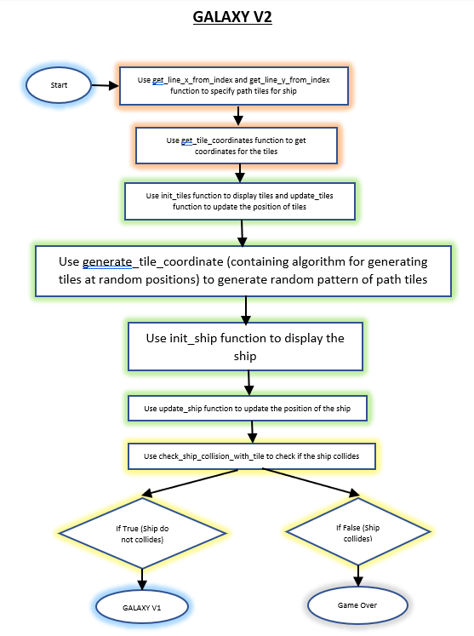
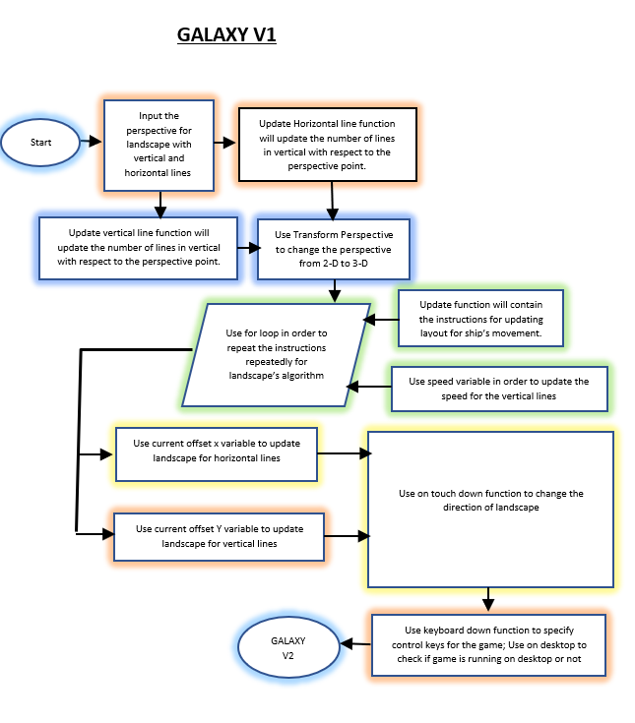
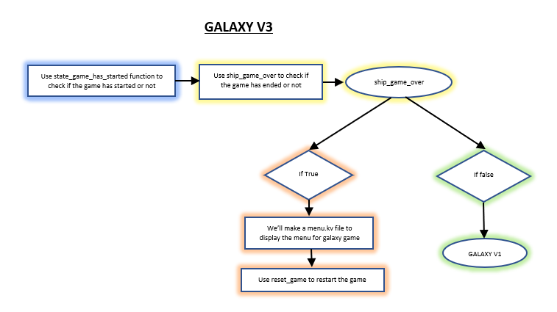
Flowchart

Slide 5
INTRODUCTION
01
What’s Galaxy?..
In this 3-Dimensional game, the player must navigate the spaceship to the left or right side to keep on the track, but if you get out of the track, your game is over.
This project will include a grid formation with perspective and movement, random land generation algorithm for ship and to finalise the project, it’ll include a menu, scoreboard, custom background and custom background sounds.
START!
START!

Slide 6
Libraries Used
Kivy Library:
Kivy is an opensource Python library that allows you to develop multi-platform graphical user interface applications on Windows, macOS, Android, iOS, Linux, and Raspberry-Pi. In addition to regular mouse and keyboard inputs, it supports multitouch events. Applications made using Kivy will appear similar across all the platforms but it also means that the applications feel or look will differ from any native application.

Slide 7
This project is sub-divided into 3 parts – V1, V2 and V3
V1 - Grid, Perspective and Landscape Movements
V2 - Land Generation, Displaying the ship and Collisions
V3 - finalising the game by adding Menu, Sounds, Background and Score

Slide 8
PART WISE PROJECT DISTRIBUTION
40%
40%
40%
40%
V1
V2
20%
20%
V3

Slide 9
CODES
02

Slide 10
Grid
V_NB_LINES – Contains the number of vertical lines
V_LINE_SPACING – Displays space between vertical lines
H_NB_LINES – Contains the number of horizontal lines
H_LINES_SPACING – Displays space between horizontal lines
init_vertical_lines function will append and display the vertical lines one after another in y axis.
init_horizontal_lines function will append and display the horizontal lines one after another in y axis.

Slide 11
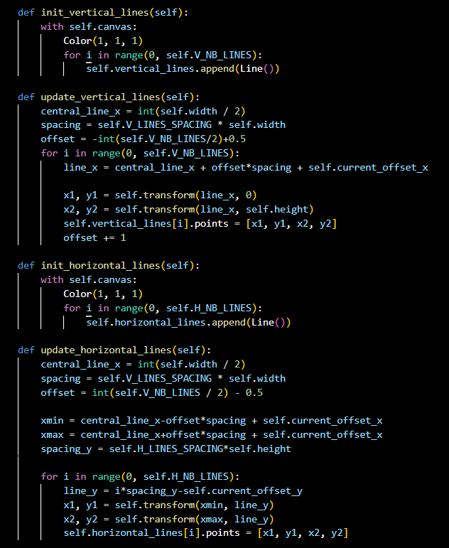
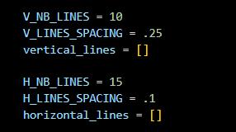
Grid

Slide 12
Perspective
transform_2d function will change the perspective from 3d to 2d.
transform_perspective function will change the perspective from 2d to 3d with respect to a perspective point.

Slide 13
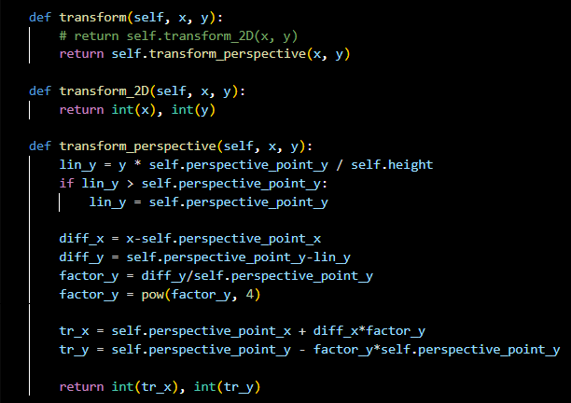
Perspective

Slide 14
Landscape Movement
SPEED variable will change the speed of y-axis.
SPEED_X variable will change the speed of x-axis.
update_vertical_lines and update_horizontal_lines functions will update the vertical lines and horizontal lined by implementing a for loop.

Slide 15
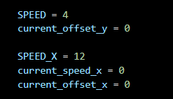
Landscape Movement

Slide 16
LAND GENERATION
NB_TILES – Will contain the number of tiles to be displayed.
init_tiles function will contain append function with loop for each tile.
pre_fill_tile_coordinates function will fill and display the initial tiles straight.
generate_tiles_coordinates will contain the algorithm to display path tiles randomly in three directions, i.e. left, right and straight.
update function will update tiles, lines and ship movements.

Slide 17
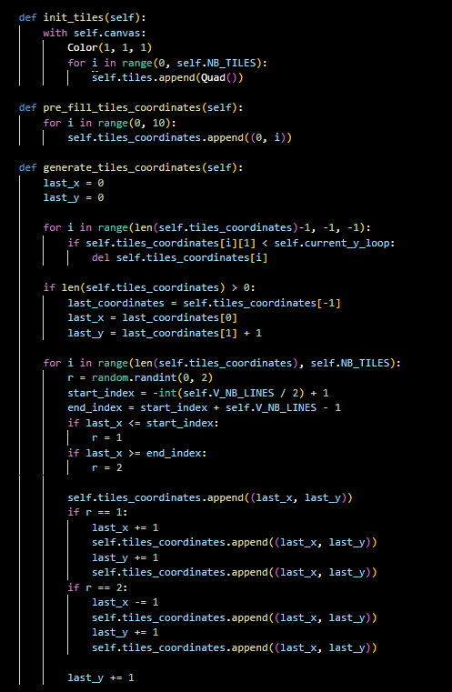
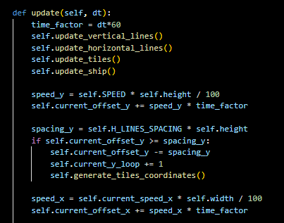
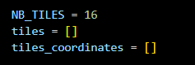
LAND GENERATION

Slide 18
DISPLAYING THE SHIP
Init_ship
init_ship functions will display the ship.
update_ship function will update the ship coordinates with respect to change in y-axis.

Slide 19
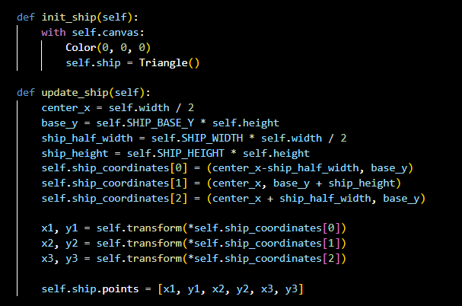
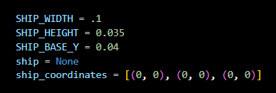
DISPLAYING THE SHIP

Slide 20
COLLISIONS
check_ship_collision function will check if the ship collides with the non-path tiles or not.
check_ship_collision_with_tile function will change the collision hitbox for ship.

Slide 21
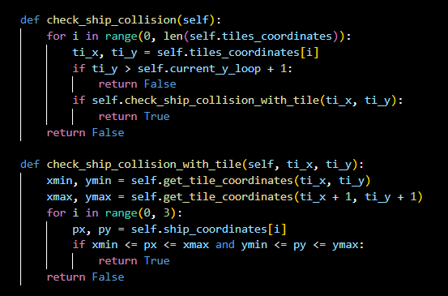
COLLISIONS

Slide 22
MENU
menu_title – will update the text for menu screen.
menu_button_title – will update the text for menu screen button.
When the ship collides state_game_over will be True and menu_title will display “GAME OVER” and menu_button_title will display “Restart”.

Slide 23
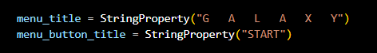
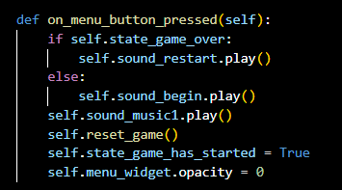
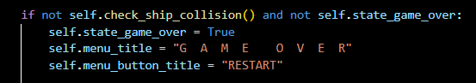
MENU

Slide 24
SOUND
init_audio function will load audio files from the designated folder with volume.
on_menu_button_pressed function contains “.play” argument which will play the designated sounds.
play_game_over_voice_sound function will play sound when the ship crashes.

Slide 25
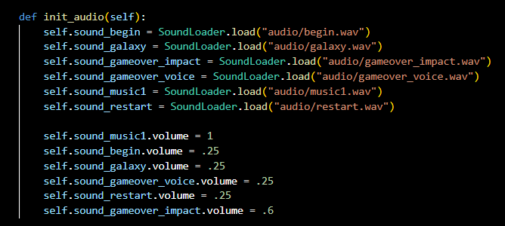
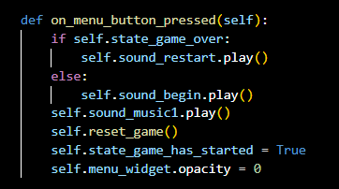
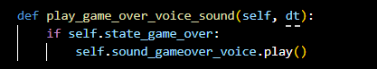
SOUND

Slide 26
BACKGROUND
“.kv” file will contain canvas argument which will contain source for background image.

Slide 27
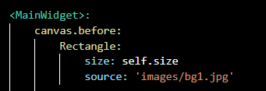
BACKGROUND

Slide 28
SCORE
score_txt will contain the updated score as the player advances in the game.

Slide 29
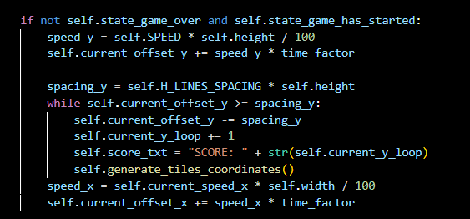
SCORE

Slide 30
THE GAME
03

Slide 31
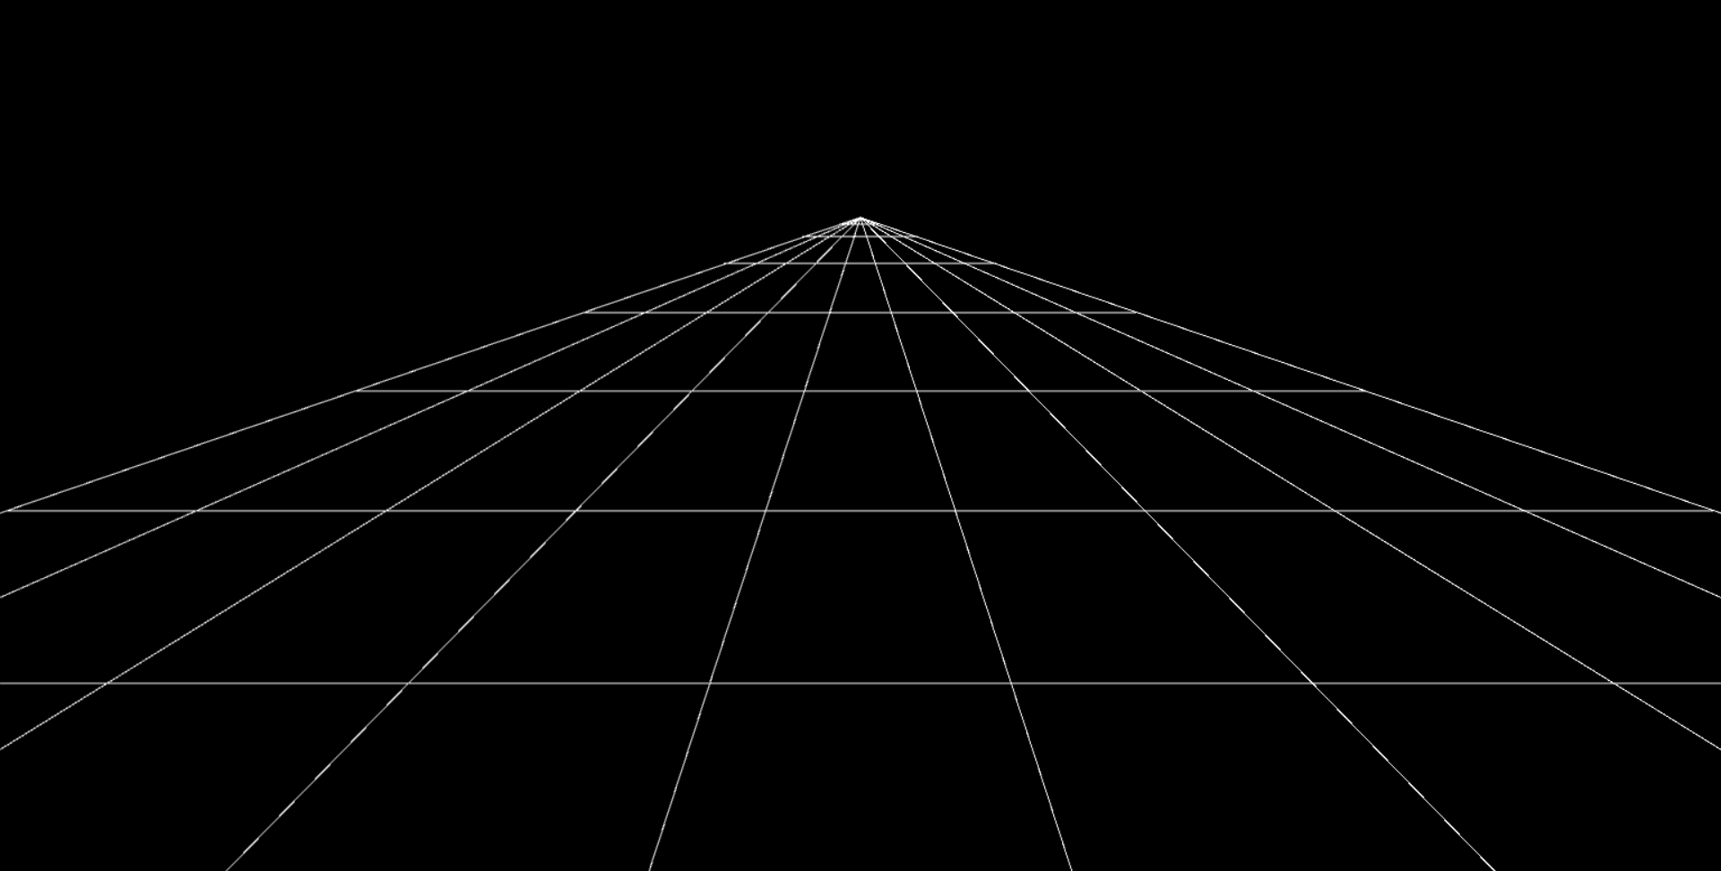
V1 OUTPUT

Slide 32

V2 OUTPUT

Slide 33
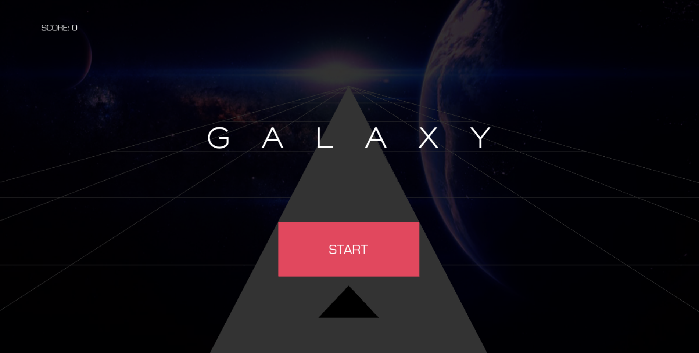

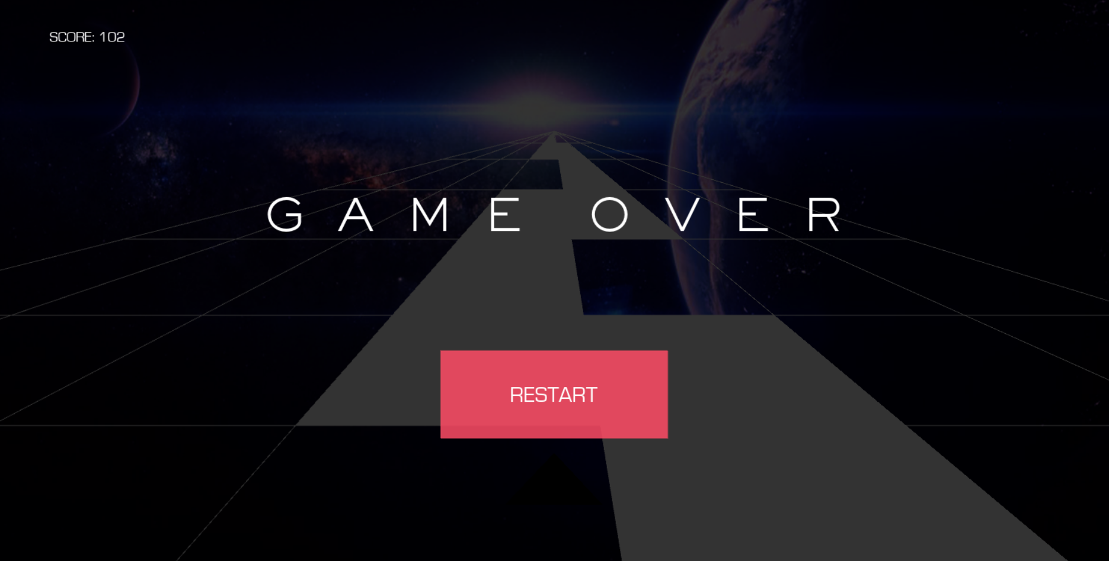
V3 OUTPUT

Slide 34
Features for Future
Debugging for collision point of the ship.
Adding keybind controls.
Making it optimized for android and ios.

Slide 35
OVER!
GAME
GAME

Slide 36
THANKS!
THANKS!

